Slide 1
Open-domain Knowledge Extraction
Niranjan Balasubramanian
University of Washington

Slide 2
To Do
Add hadoop slide
Add numbers for query logs
Remove hasTopic in schema results (rename relgrams)
Fix Rel-grams to schema slide.

Slide 3
Research Interests
Event Schemas
[EMNLP 2013]
Information Retrieval
Information Extraction
Rel-grams
[AKBC 2012]
Topic Pages
[CIKM 2009]
[ICSC 2010]
Query Reduction
[SIGIR 2010]
Performance Prediction
[SIGIR 2010]
FindAll
[CoNext 2012]
TailEnder
[IMC 2009]
Mobile Systems

Slide 4
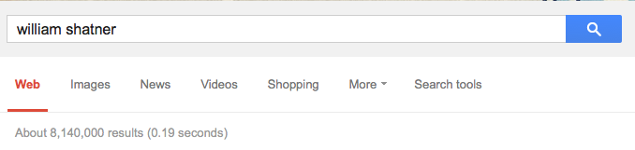
Organizing Information About Entities
Notes:
Here are two reasons why you should care about knowledge extraction.
Let me start with Information overload.

Slide 5
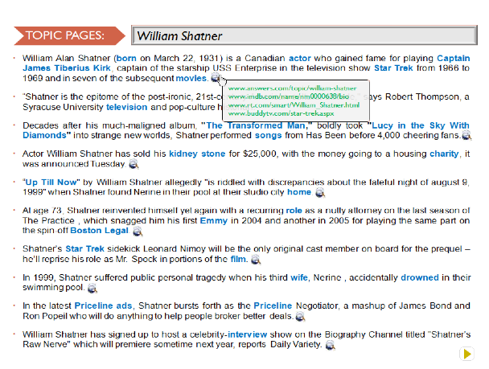



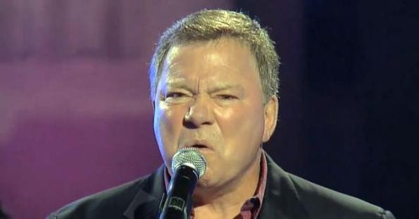
Organizing Information About Entities

Slide 6
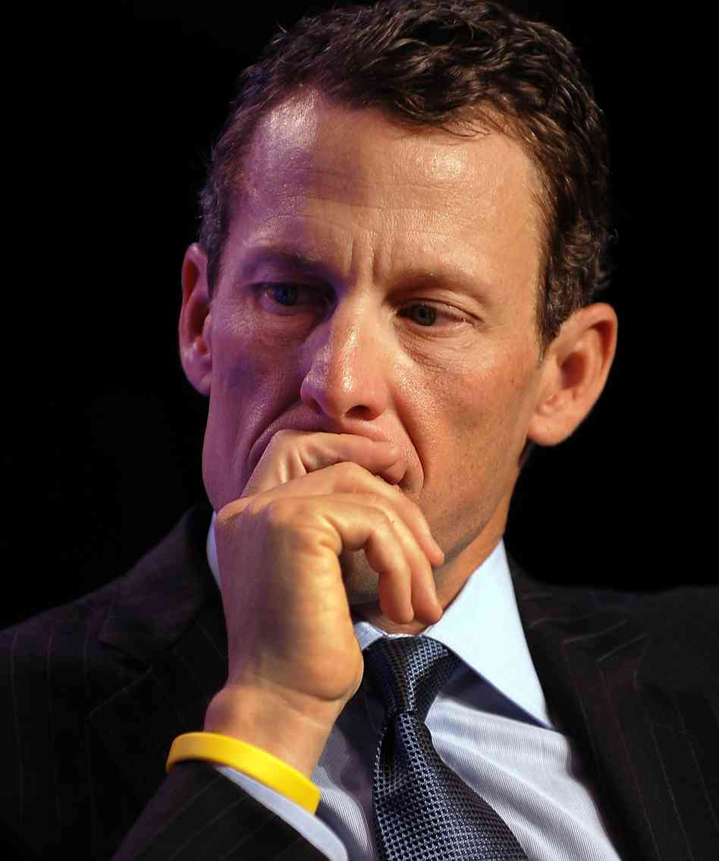
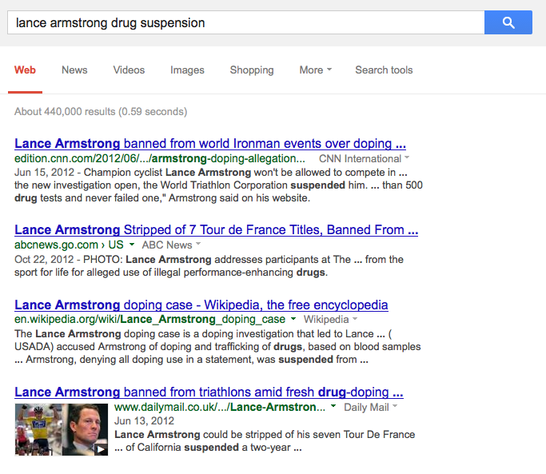
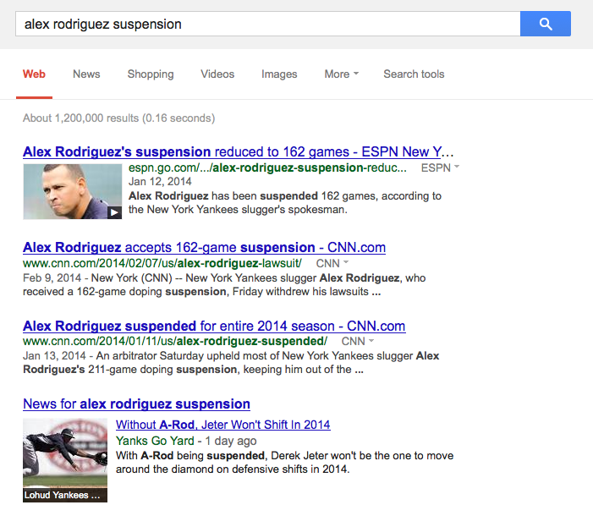
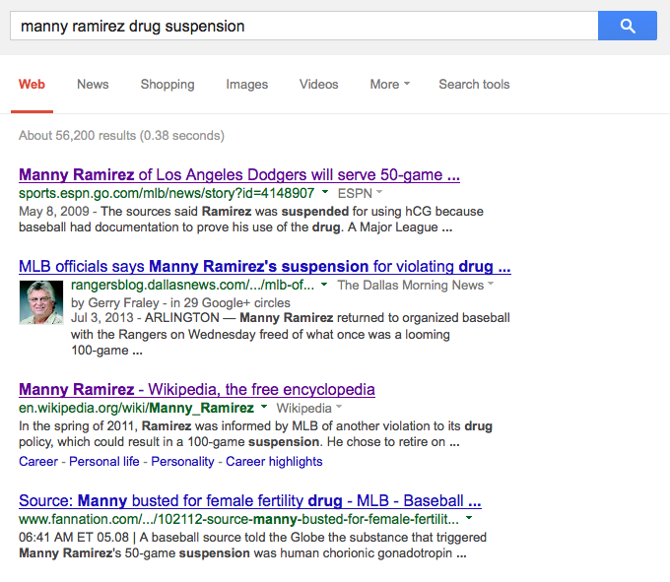
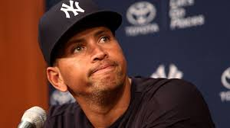
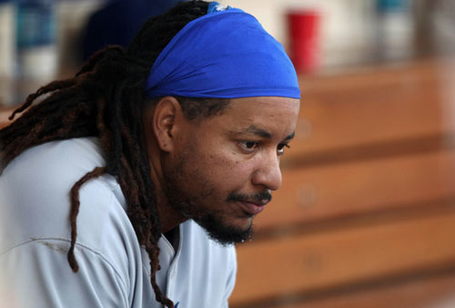
Extracting Salient Information About Events
information about players suspended for drug use
Notes:
Here are two reasons why you should care about knowledge extraction.
Let me start with Information overload.

Slide 7
Extracting Salient Information About Events
information about players suspended for drug use
Player | Drug | Ban | Team | Organization
Ramirez | hCG | 50 games | Dodgers | MLB
Rodriguez | PED | 162 games | Yankees | MLB
Armstrong | PED | for life | US Postal | USADA
… | … | … | … | …
Need knowledge about events!
Notes:
Here are two reasons why you should care about knowledge extraction.
Let me start with Information overload.

Slide 8

Question Answering
Building a system that can pass 4th Grade Exams!
A car skids along the road and smoke appears to be coming from under the tires. The heat that produces the smoke is caused by
(A) sound
(B) light
(C) friction
Need knowledge that can be used for inference.
Notes:
Another key motivation is the AI vision of achieving (if not exceeding) human-level performance on intelligence tasks.
If you are building a QA system that aims to pass 4th grade exam, you will run into questions like these, retrieval and matching techniques
alone aren’t adequate.
You need several forms of knowledge, especially in a form that can be used for inference.
Maybe I have convinced you that knowledge extraction is an useful pursuit.

Slide 9
What do I mean by knowledge? What is my goal?

Slide 10
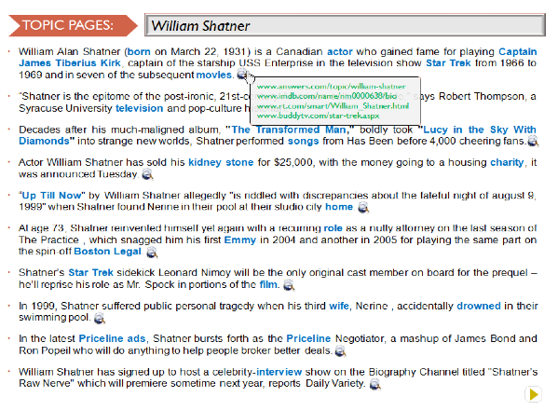
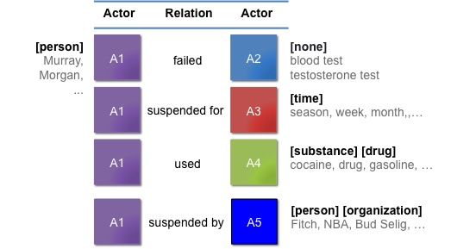

This Talk
Aspect Models for Topic Pages
Aggregate and organize information about entities.
2) Schemas for Event Extraction
Build models of open-domain events.
3) Question Answering
Answer 4th grade science exams.
Notes:
In this talk I am going to talk about three projects that broadly relate to knowledge extraction.
Extracting knowledge about events to serve as models of open-domain events.
Extracting knowledge about entities to automatically generate wikipedia-like pages.
Extracting and reasoning with knowledge for answering grade science exams.
I will spend most time on event schemas, a little bit of time on topic pages and I would like to mention on-going work in 3 and conclude with future directions.

Slide 11
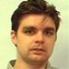
Aspect Models for Topic Pages
[CIKM 2009], [ICSC 2010]
Silviu Cucerzan
Microsoft Research

Slide 12
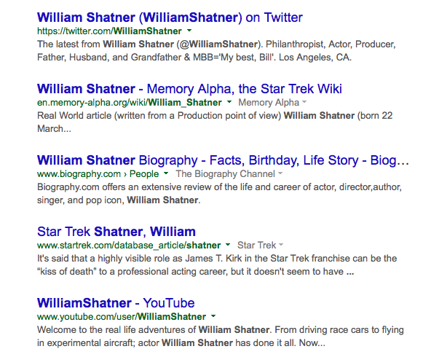
Organizing Information on Topics
Too much information
No high-level picture
Diverse aspects

Slide 13
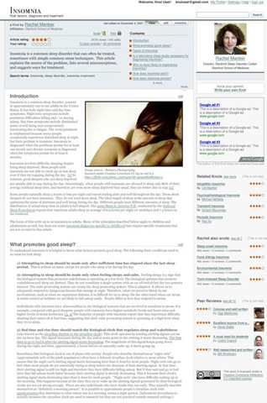
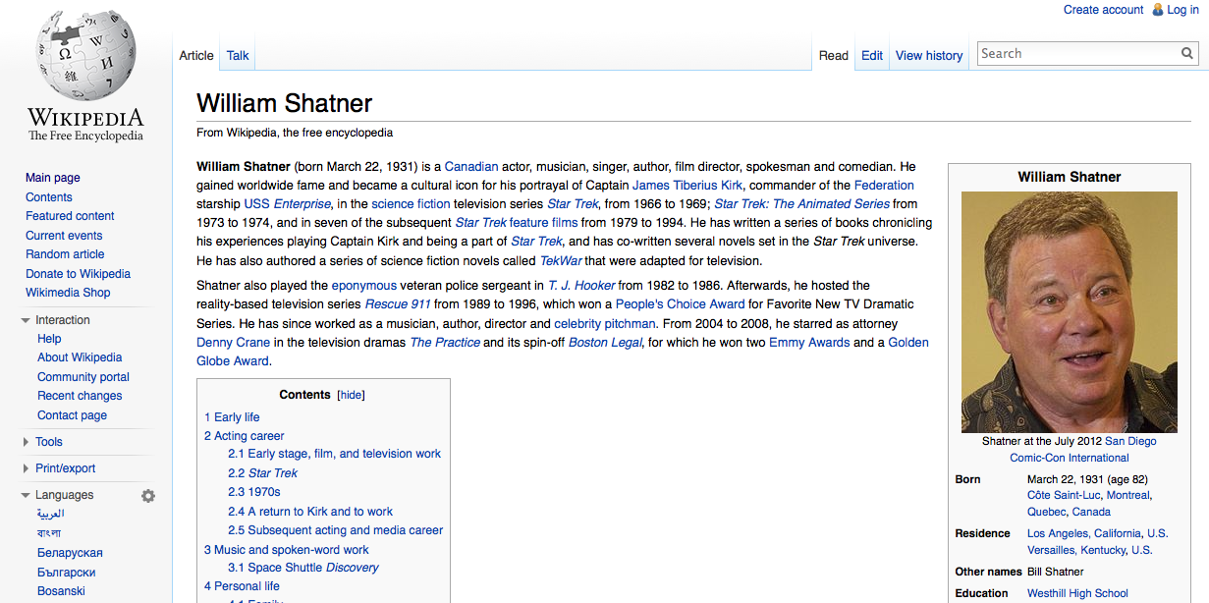
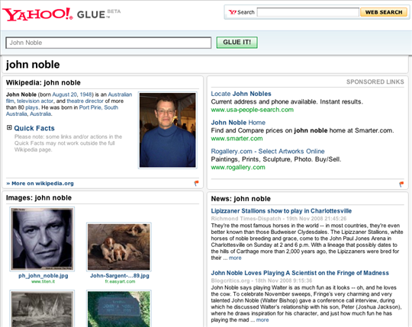
Manually Authored Solutions

Slide 14

Automatic Topic Pages
Automatically organize information on a topic.
William Shatner
1] In the latest Priceline ads, Shatner bursts forth as the Priceline Negotiator, a mashup of James Bond and Ron Popeil who will do anything to help people broker better deals.
2] Description William Alan Shatner (born on March 22, 1931) is a Canadian actor who gained fame for playing Captain James Tiberius Kirk, captain of the starship USS Enterprise in the television show Star Trek from 1966 to 1969 and in seven of the subsequent movies.
3] In 1999, Shatner suffered public personal tragedy when his third wife, Nerine , accidentally drowned in their swimming pool.
4] Shatner’s Star Trek sidekick Leonard Nimoy will be the only original cast member on board for the prequel – he’ll reprise his role as Mr. Spock in portions of the film.
5] On TV, Shatner made several guest appearances on The Practice and is featured in the spin-off series, Boston Legal, playing Denny Crane.
6] Decades after his much-maligned album, "The Transformed Man," boldly took "Lucy in the Sky With Diamonds" into strange new worlds, Shatner performed songs from "Has Been" before 4,000 cheering fans.
7] Actor William Shatner has sold his kidney stone for $25,000, with the money going to a housing charity, it was announced Tuesday.
8] William Shatner has signed up to host a celebrity-interview show on the Biography Channel titled "Shatner"s Raw Nerve" which will premiere sometime next year, reports Daily Variety.
9] Some of the best known actors of all time played on different episodes of the Twilight Zone, including William Shatner and Burgess Meredith.
10] Maybe that is William Shatner’s best birthday gift.
www.adweek.com/kaley-cuoco-and-william-shatner-team-pric..
www.hollywoodreporter.com/.../william-shatner
www.businessinsider.com/priceline-negotiator-kaley-cuo
…

Slide 15
Challenges
1) What are the key pieces of information to show?
2) Where to find the information?
3) How to organize the information?
Salient Aspects
Relevant Sentences
Order Sentences

Slide 16
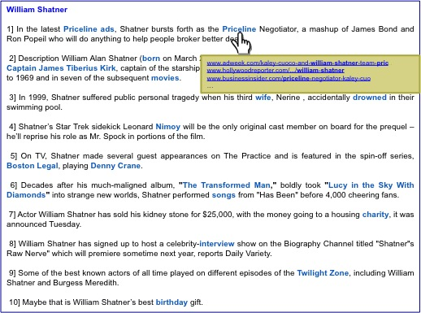
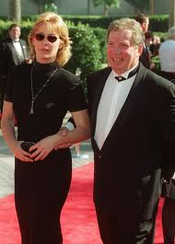
Approach
Salient Aspects
Relevant Sentences
Organize Sentences
Shatner acted in …
His book …
Shatner released albums …
As the negotiator in Priceline ads..
Nerine, his wife drowned in ….
Shatner was born in …
…
Wikipedia?
Search Results?
We use Query Logs … (size?)

Slide 17
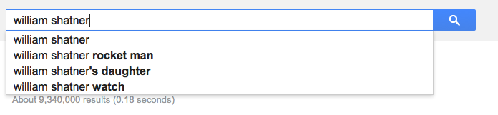
Query-log based aspect models
Query logs aggregate information needs about entities
Temporally sensitive
Complementary to information in Wikipedia

Slide 18
Aspect Models
Specific – Direct queries
movie name, award, book…
Related – Similar entities
movies, music, albums…
senator, congressman,…
General – For all entities.
spouse, other relationships…
height, age, weight,…

Slide 19
Specific Aspects
Query Logs
William Shatner
William Shatner Star Trek
William Shatner Priceline
…
…
William Shatner wife
…
…
William Shatner albums
…
…
…
Aspects
Star Trek
Priceline
Wife
Albums
…

Slide 20
Related Aspect Model
Aspects that are often queried for entities related to the query entity.
Query Entity
Related Entities
Specific Aspect Models
Related Aspect Model
…
…
…
actor
film
movie
wife
…
…
…
John Cusack
Joe Pesci
Scott Glen
…
…
…
…
Johnny Depp
…
…
…
…

Slide 21
Finding Related Entities
Search Sessions
Candidate Related Topics
Johnny Depp
Pirates of the Caribbean
Johnny Depp
Nicolas Cage
Google
John Cusack
Walmart
Joe Pesci
Johnny Depp birthday
Pirates of the Caribbean
Nicolas Cage
Google
John Cusack
Walmart
Joe Pesci
….
Top Related Entities
Nicolas Cage movies
Nicholas Cage pics
…
Nicolas Cage actor
…
John Cusack
Joe Pesci
Denzel Washington
Scott Glen
Nicolas Cage
…
…
=
Johnny Depp actor
Johnny Depp pics
…
Johnny Depp movies
…

Slide 22
Retrieving and Organizing Sentences
IR techniques to retrieve and rank sentences.
Pseudo-relevance feedback to find typical sentence.
Classifier to remove ungrammatical and mal-formed web sentences.
Organize sentences in a biographical timeline
Leverage examples in Wikipedia to learn word-precedence models.

Slide 23
Evaluation
Topic Pages vs. Search Results Summarization
400 Sentences for 20 Topics
Balasubramanian and Cucerzan, ICSC 2010

Slide 24
Summary
Automatically construct a topic page for entities using query log aspects.
Knowledge-driven content selection is useful for organizing information.
Query logs provide useful knowledge about entities.

Slide 25
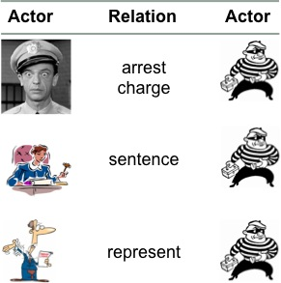
This Talk
Aspect Models for Topic Pages
Aggregate and organize information about entities.
2) Schemas for Event Extraction
Build models of open-domain events.
3) Question Answering
Answer 4th grade science exams.
Notes:
In this talk I am going to talk about three projects that broadly relate to knowledge extraction.
Extracting knowledge about events to serve as models of open-domain events.
Extracting knowledge about entities to automatically generate wikipedia-like pages.
Extracting and reasoning with knowledge for answering grade science exams.
I will spend most time on event schemas, a little bit of time on topic pages and I would like to mention on-going work in 3 and conclude with future directions.

Slide 26
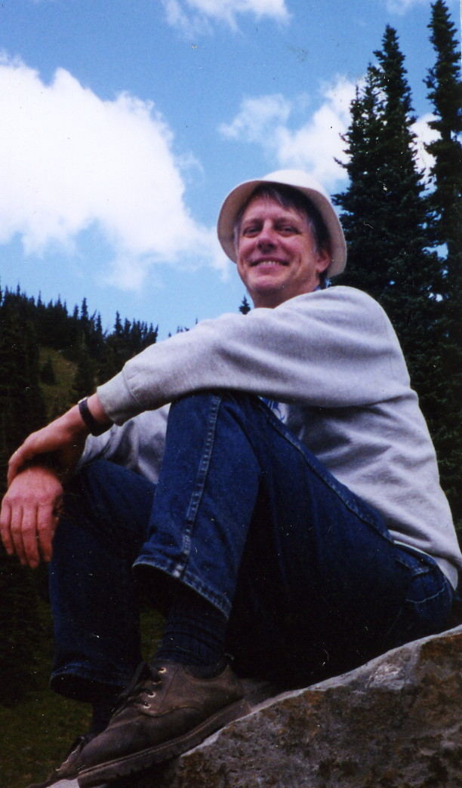
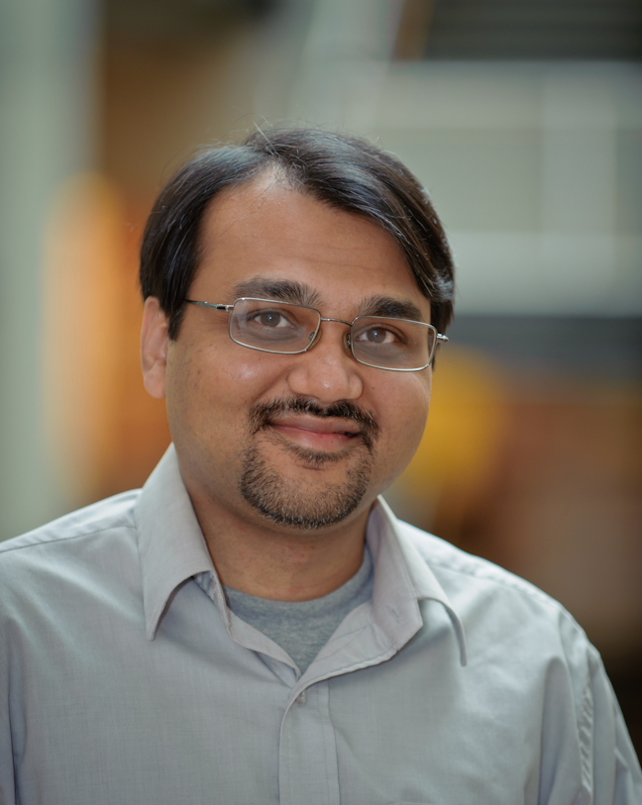
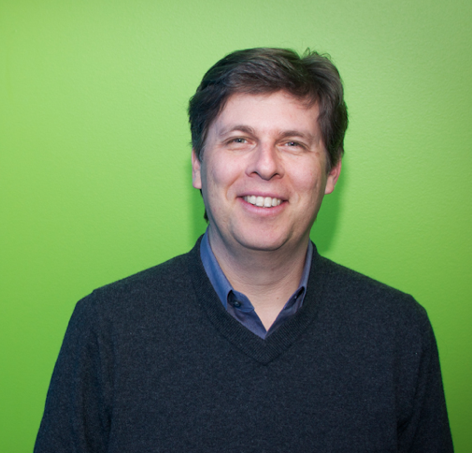
Generating Coherent Event Schemas
Rel-grams and Event Schemas
[AKBC-WEKEX 2012], [EMNLP 2013]
Stephen Soderland
University of Washington
Mausam
Indian Institute of Technology Delhi
Oren Etzioni
Allen Institute for Artificial Intelligence
Notes:
In this first part I am going to talk about joint work with Stephen Soderland, Mausam and Oren Etzioni.

Slide 27
Motivation
Find information about players suspended for drug use
Notes:
Getting back to the use case…
We are looking to find information about players suspended for drug use.
We get a bunch of web pages from a search engine. About 37000 for this one.

Slide 28
Motivation
Find information about players suspended for drug use
Player | Drug | Ban | Team | Organization
Ramirez | hCG | 50 games | Dodgers | MLB
Rodriguez | PED | 162 games | Yankees | MLB
Armstrong | PED | for life | US Postal | USADA
… | … | … | … | …
Notes:
Getting back to the use case…
We are looking to find information about players suspended for drug use.
We get a bunch of web pages from a search engine. About 37000 for this one.

Slide 29
Open Information Extraction
Extract arbitrary relationships between noun phrases.
Manny Ramirez joined a growing lineup of All-Stars linked to drugs Thursday, with the dreadlocked slugger banished for 50 games by a sport that cannot shake free from scandal.
Open IE
(Manny Ramirez, joined, a growing lineup of All-stars)
(dreadlocked slugger, was banished for, 50 games)
(dreadlocked slugger, was banished by, a sport)
Notes:
Open Information extraction aims to address the scale issue.
It can identify open-domain relationships mentioned in text.
Typically, relations are expressed as(Arg1, Relation, Arg2) formatted triple.
For example, this sentence yields three relation triples, which relate to
This scales well and can generate relations in many domains.

Slide 30
Open Information Extraction
Argument 1 | Relation | Argument 2
Manny Ramirez | joined | a growing lineup of All-Stars
the dreadlocked slugger | was banished by | a sport that cannot shake free from scandal
the dreadlocked slugger | was banished for | 50 games
Los Angeles Dodgers star | said of | he
he | did was prescribed medication by | a doctor that contained a banned substance
he | did not take | steroids
he | did was prescribed | medication
Dodgers general manager Ned Colletti | told reporters on | the field
Dodgers general manager Ned Colletti | told reporters at | Dodger Stadium
reporters | was told on | the field
Dodgers general manager Ned Colletti | told | reporters
This organization | will never condone | anything that is n't clean
reporters | was told at | Dodger Stadium
Ned Colletti | was manager of | Dodgers
It | 's certainly | a dark day
The commissioner 's office | didn't announce specific violation by | the 36-year-old outfielder… this whole situation
the 36-year-old outfielder | apologized to | the Dodgers and fans
the specific violation | did n't announce by | the 36-year-old outfielder …this whole situation
The commissioner 's office | did n't announce | the specific violation
Ramirez | had testosterone in | his body that was not natural
Ramirez | was identified in | addition
testosterone | was had in | …came from an artificial source
his body that was not natural | came from | an artificial source
Ramirez | had | testosterone
two people | told | ESPN 's Mark Fainaru-Wada
testing | However showed | Ramirez
Ramirez | had testosterone | two people
they | would fight | a suspension
Too many relations!
Notes:
However, it extracts too many relationships. Open Ie will output all relations it finds in texts.

Slide 31
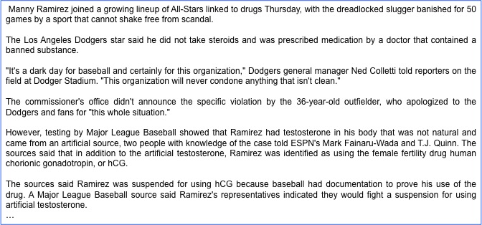
Event Extraction using Templates
Player | Drug | Ban | Team | Organization
Ramirez | hCG | 50 games | Dodgers | MLB
Template IE
Suspension Schema
Actors Roles
Player Person who fails the test
Drug Drug used by the player
Ban Time for which the player is suspended
Team Player’s team
Organization Organization that suspends the player

Slide 32
Will this scale?
How to generate schemas for arbitrary open-domain events?
bombing
Test Drug test that was administered
Player Person who fails the test
Team Player’s team
Organization Organization that suspends the player
Drug Drug used by the player
Duration Time for which the player is suspended
Lawsuit
Test Drug test that was administered
Player Person who fails the test
Team Player’s team
Organization Organization that suspends the player
Drug Drug used by the player
Duration Time for which the player is suspended
Arrest
Test Drug test that was administered
Player Person who fails the test
Team Player’s team
Organization Organization that suspends the player
Drug Drug used by the player
Duration Time for which the player is suspended
Suspension
Actors Roles
Test Drug test that was administered
Player Person who fails the test
Team Player’s team
Organization Organization that suspends the player
Drug Drug used by the player
Duration Time for which the player is suspended
Prior Work
Manual and limited to a small number of domains
Automatic method resulted in incoherent schemas.
[Chambers and Jurafsky, 2009]

Slide 33

Task Definition
Generate schemas about events mentioned in a corpus.
Input: News Texts
Output: Event Schemas
bombing
Test Drug test that was administered
Player Person who fails the test
Team Player’s team
Organization Organization that suspends the player
Drug Drug used by the player
Duration Time for which the player is suspended
Lawsuit
Test Drug test that was administered
Player Person who fails the test
Team Player’s team
Organization Organization that suspends the player
Drug Drug used by the player
Duration Time for which the player is suspended
Arrest
Test Drug test that was administered
Player Person who fails the test
Team Player’s team
Organization Organization that suspends the player
Drug Drug used by the player
Duration Time for which the player is suspended
Suspension
Actors Roles
Test Drug test that was administered
Player Person who fails the test
Team Player’s team
Organization Organization that suspends the player
Drug Drug used by the player
Duration Time for which the player is suspended

Slide 34
Event Schemas
A set of actors and the roles they participate in.
Actor
Relation
Actor
[person]
Murray,
Morgan,
...
A1
A2
[none]
blood test
testosterone test
failed
Suspension
Actors Roles
Test Drug test that was administered
Player Person who fails the test
Team Player’s team
Organization Organization that suspends the player
Drug Drug used by the player
Duration Time for which the player is suspended
A1
A3
[time]
season, week, month,,…
suspended for
A1
A4
[substance] [drug]
cocaine, drug, gasoline, …
used
A1
A5
[person] [organization]
Fitch, NBA, Bud Selig, …
suspended by
1) Not labeled actors.
2) Roles via relations.
Notes:
Many actors and useful relations.

Slide 35
Observations
Facts co-mentioned in text likely belong to the same event
Open IE relations present a succinct representation of facts.
John was arrested by police … They charged him with armed robbery
Ramirez failed a drug test … He was suspended for 50 games
A bomb exploded in a market … The group claimed responsibility.
Democrats favored the bill … The bill was overwhelmingly opposed by the republicans
(John, was arrested by, police) … (They, charged him with, armed robbery)
(Ramirez, failed, a drug test) … (He, was suspended for, 50 games)
(A bomb, exploded in, a market) … (The group claimed responsibility)
(Democrats, favored, the bill) … (The bill, was overwhelmingly opposed by the republicans)

Slide 36
Our Solution
Use Open IE relations to generate schemas!
Input: News Texts
Output: Event Schemas
Open IE Relations
Relational Co-occurrence
(Rel-grams)

Slide 37
Representing Relations
Text:
He cited a new study that was released by UCLA in 2008.
Extractions:
(He, cited, a new study)
(a new study, was released by, UCLA)
(a new study, was released in, 2008)
Normalized:
(he, cite, study)
(study, be released by, UCLA)
(study, be released in, 2008)
Generalized:
([person], cite, [activity])
([activity], be released by, [organization])
([activity], be released in, [time-unit])
Ollie [Mausam et al, 2012]
State-of-the-art open extractor.
Extract Argument Head:
10 people => people
group of passengers => passengers
France’s president => president
Assign Semantic Classes
Named entity classes
Person, Organization, Location,…
29 WordNet classes
Drug, Structure, Device, Activity, …

Slide 38
Rel-grams – A model of relation co-occurrence
How likely are we to see relation T’ in the vicinity of T?
Probability of seeing T’ in the vicinity of T
Delta-smoothed for sparse events.
Importance decays with length of window
Notes:
We formalize this intuition using a simple bi-gram co-occurrence model of relations.

Slide 39
Rel-grams Tabulation
Rel-grams Tabulation
T | T’ | #1(T, T’) | #2(T, T’)
(he, cited, study) | (study, be released by, UCLA) | 1 | 2
([person], cited, [activity]) | ([activity], released by, [organization]) | 17 | 19
([person], cited, X:[activity]) | (X:[activity], released by, [organization]) | 14 | 14
… | … | … | …
(X:[person], failed, test) | (X:[person], suspended for, [activity]) | 23 | 24
(bomb, exploded in, Bhagdad) | (group, claimed, responsibility) | 1 | 7
([device], exploded in, [location]) | ([organization], claimed, responsibility) | 14 | 11
Make a Hadoop slide.

Slide 40
Does Rel-gram capture useful knowledge?
(a) Does T entail T’ or T’ entail T ?
If you knew that : ([device], exploded in, [location]),
would you expect? : ([organization], claimed, responsibility)
or vice versa.
(b) Do T and T’ capture information on the topic of an single event?
Is Topic (T) = Topic (T’)
A large proportion of Rel-grams carry useful information about events.
74% of Rel-grams are valid.
83% of the valid Rel-grams are entailments
90% of the valid Rel-grams have the same topic.

Slide 41
Building Schemas
T | T’ | #1(T, T’) | #2(T, T’)
(he, cited, study) | (study, be released by, UCLA) | 1 | 2
([person], cited, [activity]) | ([activity], released by, [organization]) | 17 | 19
([person], cited, X:[activity]) | (X:[activity], released by, [organization]) | 14 | 14
… | … | … | …
(X:[person], failed, test) | (X:[person], suspended for, [activity]) | 23 | 24
(bomb, exploded in, Bhagdad) | (group, claimed, responsibility) | 1 | 7
([device], exploded in, [location]) | ([organization], claimed, responsibility) | 14 | 11
bombing
Test Drug test that was administered
Player Person who fails the test
Team Player’s team
Organization Organization that suspends the player
Drug Drug used by the player
Duration Time for which the player is suspended
Lawsuit
Test Drug test that was administered
Player Person who fails the test
Team Player’s team
Organization Organization that suspends the player
Drug Drug used by the player
Duration Time for which the player is suspended
Arrest
Test Drug test that was administered
Player Person who fails the test
Team Player’s team
Organization Organization that suspends the player
Drug Drug used by the player
Duration Time for which the player is suspended
Suspension
Test Drug test that was administered
Player Person who fails the test
Team Player’s team
Organization Organization that suspends the player
Drug Drug used by the player
Duration Time for which the player is suspended

Slide 42
Rel-grams to Schemas
Schemas correspond to sets of relations that co-occur.
T | T’ | #1(T, T’) | #2(T, T’)
(he, cited, study) | (study, be released by, UCLA) | 1 | 2
([person], cited, [activity]) | ([activity], released by, [organization]) | 17 | 19
([person], cited, X:[activity]) | (X:[activity], released by, [organization]) | 14 | 14
… | … | … | …
(X:[person], failed, test) | (X:[person], suspended for, [activity]) | 23 | 24
(bomb, exploded in, Bhagdad) | (group, claimed, responsibility) | 1 | 7
([device], exploded in, [location]) | ([organization], claimed, responsibility) | 14 | 11
Relation graph.
Personalized PageRank

Slide 43
System Output
Actor
Relation
Actor
[person]
Murray,
Morgan,
...
A1
A2
[none]
test
failed
A1
A3
[time]
season, week, month,,…
suspended for
A1
A4
[substance] [drug]
cocaine, drug, gasoline, …
used
A1
A5
[game] [activity]
violation, game, abuse, …
suspended for
A1
A6
[location]
desert, Simsbury, Albany, …
was in
A1
A7
[person] [organization]
Fitch, NBA, Bud Selig, …
suspended by
Notes:
Many actors and useful relations.

Slide 44
Coherence Issue in Prior Work
Actor
Relation
Actor
infection
fire
A1
A2
disease
caused
disease
A2
A1
infection
fire
spread
infection
fire
A1
broke out
extinguished
A1
infection
fire
Notes:
… of infection spreading and fire spreading.
What is wrong with mixing distinct events?
Relations that don’t fit in one event.
Example: extinguishing doesn’t fit infection event.
Can result in triples that make no sense (disease, spread, fire)
There are plenty of other examples:
airlines scheduling flights,
government scheduling meetings,
nba, scheduling games
Why does this happen

Slide 45
Evaluating Schemas
Prior automatic method [Chambers and Jurafsky, 2009]
Relation Coherence
1) Are the relations in a schema valid?
2) Do the relations belong to the schema topic?
Actor coherence:
3) Do the actors have a useful role within the schema?
4) What fraction of instances fit the role

Slide 46
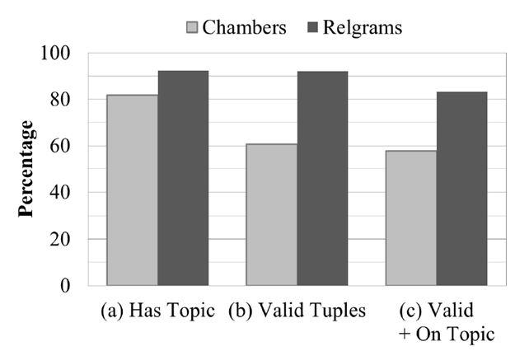
Results
More coherent sets of relations and actors!
Topic coherence
Remove has topic
Balasubramanian et al., EMNLP 2013

Slide 47
Summary
Developed a fully automatic method for discovering event schemas.
Scales to arbitrary domains.
Improved coherence compared to prior state-of-the-art.
Released a set of 2K schemas that were mined from New York Times.
Released a set of 1.1 Million Rel-grams.

Slide 48
This Talk
Aspect Models for Topic Pages
Aggregate and organize information about entities.
2) Schemas for Event Extraction
Build models of open-domain events.
3) Question Answering
Answer 4th grade science exams.
Notes:
In this talk I am going to talk about three projects that broadly relate to knowledge extraction.
Extracting knowledge about events to serve as models of open-domain events.
Extracting knowledge about entities to automatically generate wikipedia-like pages.
Extracting and reasoning with knowledge for answering grade science exams.
I will spend most time on event schemas, a little bit of time on topic pages and I would like to mention on-going work in 3 and conclude with future directions.

Slide 49


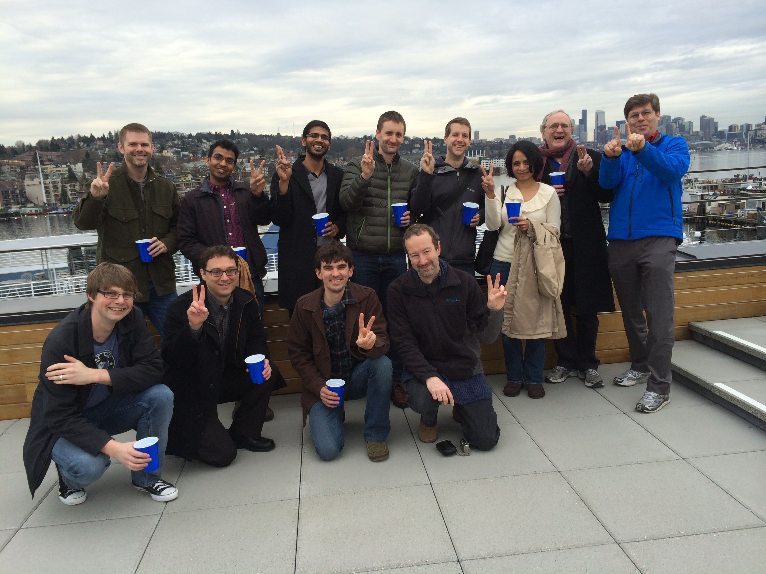

Question Answering
[On-going work]
Joint work with:
Notes:
In this second part, I am going to talk about on going work at AI2, where I co-lead the design and development of a QA system that can answer grade level science exams.
We are used externally published standardized exams w/ increasing levels of sophistication in knowledge and reasoning.

Slide 50
4th Grade Science Questions
One hot, summer day it rained very heavily. After the rain, a plastic pan on a picnic table had 2 cm of rainwater in it. Four hours later, all the rainwater in the pan was gone.
Which process caused the rainwater in the pan to disappear as it sat
outside in the hot air?
A condensation
B evaporation
C precipitation
D erosion
If the day were cool instead of hot, the rainwater in the pan would have
disappeared
A slower
B faster
C in the same amount of time
Definition
Qualitative relationship
Notes:
Multiple choice questions
-- easy, well relatively easy to evaluate
-- explainable
Externally published standardized exams w/ increasing levels of sophistication in knowledge and reasoning.
NY state regents exams.

Slide 51
Keyword Matching alone isn’t adequate.
Which example describes an organism taking in nutrients?
(A) a dog burying a bone
(B) a girl eating an apple
(C) an insect crawling on a leaf
(D) a boy planting tomatoes in a garden
Question
A boy planting tomatoes in a garden describes an organism taking in nutrients
Matching Sentence
The roots of the plant take in water and nutrients.

Slide 52
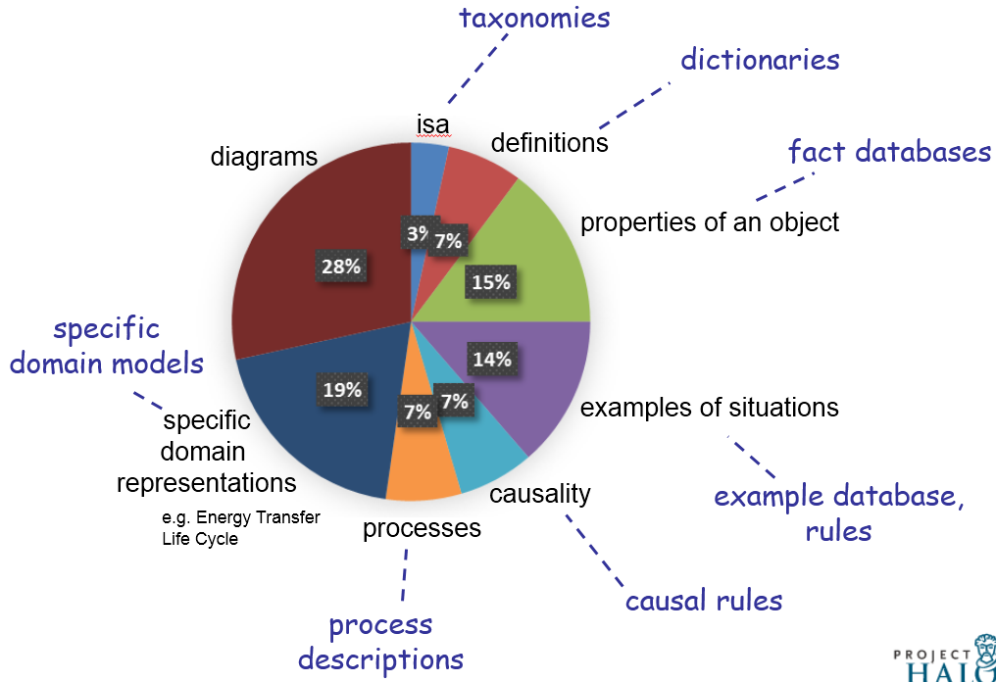
4th Grade Knowledge Requirements
[AKBC-WEKEX, 2013]
Notes:
So what does it take to pass this exam?
Diagram understanding.
Simple taxonomic knowledge such as isa, definitions,
properties of object (ice is solid),
examples of situations (organism taking in nutrients),
Higher-order relations
causality (gravity / causes / objects to fall to the ground),
function
requirements
enablement
process descriptions (sweat / moistens/ skin) (cool air/ against/ wet skin) cools (animal)
domain models (predator eats prey, predators go up, prey go down)

Slide 53
Our Approach
Extract knowledge through machine-reading of texts and existing sources.
Study guides
Web texts
Definitions
Multiple reasoning methods.
Text-based reasoning (e.g., structured matching)
Semi-formal deduction using text-based propositions.
Probabilistic deductive reasoning in First-order-logic.
Current focus
Notes:
So what does it take to pass this exam?
Diagram understanding.
Simple taxonomic knowledge such as isa, definitions,
properties of object (ice is solid),
examples of situations (organism taking in nutrients),
Higher-order relations
causality (gravity / causes / objects to fall to the ground),
function
requirements
enablement
process descriptions (sweat / moistens/ skin) (cool air/ against/ wet skin) cools (animal)
domain models (predator eats prey, predators go up, prey go down)

Slide 54
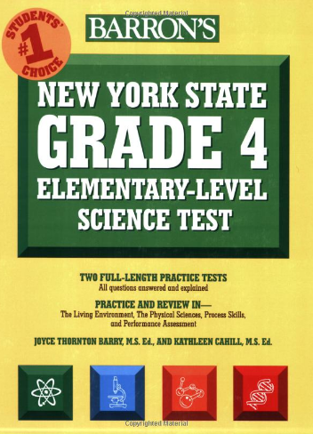
Machine-reading to Extract Knowledge
WordNet
Open IE
Patterns over Study Guide

Slide 55
Answering Questions using Knowledge
Question Interpretation
Reasoning using retrieved knowledge
Study
guide
Web
Defns
Cause/Effect
Action/Purpose
Taxonomic
…
Knowledge

Slide 56
Question Interpretation
Which example describes an organism taking in nutrients?
(A) a dog burying a bone (B) a girl eating an apple (C) an insect crawling on a leaf
(D) a boy planting tomatoes in a garden
Assertion
a girl eating an apple describes an organism taking in nutrients
Question Relation
[girl eat apple] EXAMPLE [organism take in nutrients]

Slide 57
Retrieving Supporting Evidence
Question Relation
[girl eat apple] EXAMPLE [organism take in nutrients]
Evidence
[animals eat] EFFECT [animals get nutrients]
Animals must eat in order to get nutrients.
[cow eating grass] EXAMPLE [animal eating plants]
Cow eating grass is an example of an animal eating plants.
…

Slide 58
Matching as Reasoning
Question Relation
[girl eat apple] EXAMPLE [organism take in nutrients]
Problem Statement
Known:
To Determine:
[girl eat apple] [organism take in nutrients]
Evidence
[animals eat] [animals get nutrients]
EFFECT
Relation

Slide 59
Matching as Reasoning
Question Relation
[girl eat apple] EXAMPLE [organism take in nutrients]
Problem Statement
Known:
To Determine:
[girl eat apple] [organism take in nutrients]
girls ISA animal
animal ISA organism
Evidence
[animals eat] [animals get nutrients]
EFFECT
Relation

Slide 60
4th Grade Science Exam Results
Passing Grade (65)
Accuracy
Haven’t passed yet!

Slide 61
Summary
Question answering to pass grade-level exams is challenging.
Requires a wide variety of knowledge
Requires a range of reasoning methods.
An exciting pursuit for AI research!

Slide 62
Future Work
Reasoning with automatically extracted knowledge
To Prove: Iron nail is a conductor of electricity.
Evidence: Metals are excellent conductors of electricity and heat.
Deductive Reasoning
To prove:
iron-nail(n) => conductor(n, y) ^ electricity(y)
Known:
[Property of metals]
E1: metal(x) => conductor(x, y) ^ electricity(y)
[Compound noun relationship]
E2: iron-nail(x) => made-of(x, iron)
[Transfers-through rule]
E3: made-of(x, iron) => iron(x)
[ISA]
E4: iron(x) => metal(x)
Deduction:
iron nail is made of iron
+ iron is a metal
+ metals are conductors of electricity
=> iron nail is a conductor of electricity
Challenges
Uncertainty
Gaps
Variability
Multiple sources

Slide 63

Future Work
Information Retrieval and Mobile Search
[IMC 2009]
[CoNext 2012]

Slide 64
Thanks. Questions?

Slide 65
Future Work
Extracting Richer Knowledge Forms
Photosynthesis is a process used by plants to convert light energy, normally from the sun, into chemical energy that can later used to fuel the organism’s activities.
occurs in
sun
photosynthesis
plant [organism]
source
input
output
source
agent
convert to
light energy
chemical energy
activities
Challenges:
Implicit relations
Reference resolution
Aggregating information from multiple sentences

Slide 66
In context
Open Event Extraction
Acquisition
Research study
Legislation
Open Domain
Open Event Schemas
[EMNLP 2013]
[AKBC-WEKEX 202]
Open Relation Extraction
is an album by,
has a Ph.D. in,
made a promise to,…
Fine-grained
Actor, Architect, …
Airline, Sports team, …
City, Country, mountain, ….
Template-based Extraction
Bombing
Arrest
Arson
…
Traditional IE
acquired-by
employed-by
president-of
…
Named-entities
Person
Organization
Location
Misc.
Small Domains
Entities
Relations
Events
Notes:
Well studied problem.
Several successful systems and products exist.
Mostly supervised methods.

Slide 67
Future Work
Graph-based
AMR
Probabilistic Inference + FOL
BLUE
First-order logic
Tuples
Variablized Rules
Propositional logic
Tuple Rules
Phrasal Rules
metal(x) => conductor(x, Electricity)
substance(x, metal) => metal(x)
Inference
Textual Re-write Rules
Targeted IE
animal eat => animal get nutrients
(animal, eat, _) => (animal, get, nutrients)
Alignment + Matching
Open IE
Matching
BOW
No Rules
Lexical + Relations
IF-THEN rules
Variablized Rules
Semantic
Representation
Notes:
Finally, we would like to use more formal reasoning where possible.
For example we could extract rules in FOL from text.
if x is a metal then x is a conductor of electricity.
This requires extracting rules that require variablized representation of entities. etc.
And then there are deeper formalisms that involve representing the semantics of each verb tied to a particular ontology
Advances are making this the right time to pursue these efforts.

Slide 68
Future Work
Reasoning with automatically extracted knowledge
To Prove: Animals get energy for growth from food.
Evidence: Eating a variety of the right types of food provides energy for
growth and activity.
Graph-based Reasoning
Known
To Determine
get
provide
energy
animal
energy
food
eat
purpose
purpose
growth
?x
food
growth

Slide 69
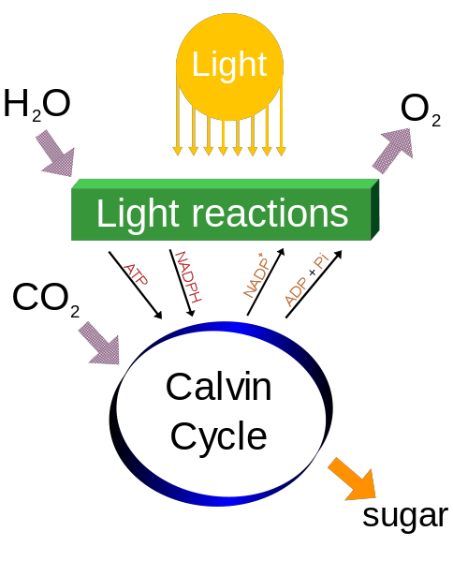
Future Work – Extracting Richer Structures
Photosynthesis
Inputs : H₂O, CO₂
Outputs : O_{2,} sugar
Energy source : sunlight
Sub-Events : Light Reactions
Sub-Process : Calvin Cycle
Calvin Cycle
Inputs : CO2, ATP, NADPH
Outputs : NADP+, ADP+, Ph
Energy source : sunlight
Sub-Events : Light Reactions
Sub-Process : Calvin Cycle

Slide 70
Future Directions
Knowledge extraction toward richer structures.
Scripts with causal and temporal links.
Processes with I/O, actors, and their relations.
Extracting implicative (IF-THEN) rules from text.
Applications
Building extractors for Open event schemas.
Apply event knowledge to improve co-reference.
Schemas for single-document summarization
Information Extraction
Bootstrapping from high-precision models of phenomena
-- Schema relations as a starting point for building extractors.
-- Explicit causal and temporal links to detect implicit links
Application driven development.

Slide 71
Future Directions
Reasoning with automatically extracted knowledge
Handle gaps and uncertainty via probabilistic methods.
Combining robust shallow methods with formal reasoning.
Broad-coverage methods for bridging gaps in knowledge.
Applications
Question answering
Knowledge-based population
Common-sense reasoning
Information Extraction
Develop mechanisms that help identify what is missing.
Feature-based entailments lack explanatory powers
Find balance between extraction difficulty vs. reasoning complexity.
Formal representations ease reasoning but are also harder to extract.

Slide 72
Future Directions
Semantic representations for Information Retrieval
Previous extraction techniques did not scale.
Open Information Extraction does!
Facilitating information access in Mobile devices
Knowledge-driven retrieval and organization
Pro-active solutions for improving access to content.
Information Retrieval
Mobile
Systems

Slide 73
Future Work
Deductive
Metal fork is made of metal + metals conduct electricity.
=> Metal fork conducts electricity.
Abductive Reasoning
Car skids on road. Smoke is produced under the tires.
What generated the heat that produced the smoke?
Qualitative Reasoning with domain models
If predator population increases then prey population will decrease.
If temperature increases evaporation rate increases.
Diagrammatic Reasoning

Slide 74
Future Work
Propositional logic
Tuple Rules
Phrasal Rules
Inference
Textual Propositions
Targeted IE
animal eat => animal get nutrients
(animal, eat, _) => (animal, get, nutrients)
Alignment + Matching
Open IE
Matching
BOW
No Rules
Lexical + Relations
IF-THEN rules
Representation
Notes:
We have begun to use some of these relations as text-based “propositional” rules.
For e.g. animal eat => animal get nutrients.
Then we can do inference in prop.logic.
However because the propositions are textual we have a mismatch problem.
We are exploring combining matching based approaches

Slide 75
Future Work
Graph-based
AMR
Probabilistic Inference + FOL
BLUE
First-order logic
Tuples
Variablized Rules
Propositional logic
Tuple Rules
Phrasal Rules
metal(x) => conductor(x, Electricity)
substance(x, metal) => metal(x)
Inference
Textual Re-write Rules
Targeted IE
animal eat => animal get nutrients
(animal, eat, _) => (animal, get, nutrients)
Alignment + Matching
Open IE
Matching
BOW
No Rules
Lexical + Relations
IF-THEN rules
Variablized Rules
Semantic
Representation
Notes:
Finally, we would like to use more formal reasoning where possible.
For example we could extract rules in FOL from text.
if x is a metal then x is a conductor of electricity.
This requires extracting rules that require variablized representation of entities. etc.
And then there are deeper formalisms that involve representing the semantics of each verb tied to a particular ontology
Advances are making this the right time to pursue these efforts.

Slide 76
Sample Rel-grams
T | T’ | Valid? | Relation?
(lawsuit, be file by, X) X : [organization] X = union, Trust Insurance co., .. | (Y, to hear, argument) Y : [person] Y = judge | Yes | Entails
(lawsuit, be file by, X) X company, Powers, … | (X, be base in, Y) Y = {Washington, Kansas City, …} | Yes | Topic
(lawsuit, be file by, X) X = {union, Trust Insurance co., ..} | (Y, be for, comment) Y = {official, Officials, Oliver} | No | None

Slide 77
Rel-grams Evaluation
A sample of 1500 Rel-grams from the Top 10%
Percentage
A large proportion of Rel-grams carry useful information about events.
Balasubramanian et al., EMNLP 2013
Notes:
Tuple validity is a problem:
Open IE is about 75% accurate.
Rel-gram the errors multiply!
Strong implication results show there is a signal here.

Slide 78
Finding Related Tuples
Create a graph from Rel-grams
Nodes = Generalized tuples
Edge = Symmetric conditional probability
Use high connectivity nodes as seeds.
Centrality indicates salience.

Slide 79
Retrieving Sentences
For a given topic and an aspect which sentence to pick?
Topic: Adrien Brody
Aspect: The Pianist
After The Pianist Brody has appeared in four very different movies.
Adrien Brody, best known for his Oscar-winning performance in “The Pianist,” was in the audience Friday at the opening.
2008 Academy Award winner Rachel Weisz (The Constant Gardener), Academy Award winner Adrien Brody (The Pianist), Mark Ruffalo (Zodiac), and Academy Award nominee ...
Adrien Brody received widespread recognition when he was cast as the lead in Roman Polanski’s The Pianist (2002).
Adrien Brody is a New York actor who is known to international audiences as the star of Roman Polanski’s 2002 film, The Pianist.
Notes:
Standard IR techniques to enhance the asepc

Slide 80
Retrieving Sentences
Find the typical relationship between the topic and aspect.
Topic: Adrien Brody
Aspect: The Pianist
After The Pianist Brody has appeared in four very different movies.
Adrien Brody, best known for his Oscar-winning performance in “The Pianist,” was in the audience Friday at the opening.
2008 Academy Award winner Rachel Weisz (The Constant Gardener), Academy Award winner Adrien Brody (The Pianist), Mark Ruffalo (Zodiac), and Academy Award nominee ...
Adrien Brody received widespread recognition when he was cast as the lead in Roman Polanski’s The Pianist (2002).
Adrien Brody is a New York actor who is known to international audiences as the star of Roman Polanski’s 2002 film, The Pianist.
….
Aspect Context Model
actor 0.3
star 0.2
win 0.2
film 0.2
2002 0.1
…
Notes:
Standard IR techniques to enhance the asepc

Slide 81
Building Schemas from Related Tuples
Extract actors from arguments.
Use equality constraints.
Merge candidates that share the same relation.
Use type compatibility rules.
Tuples | Page Rank
[person], suspended by, [org] | 1.0
[person], used, [substance] | 0.9
[person], suspended for, [activity] | 0.8
[person], failed, test | 0.7
… | …
Ramirez, used, [substance] | 0.3
… | …
… | …
Tuples | Page Rank
A1: [person], suspended by, A2: [org] | 1.0
A3: [person], used, A4: [substance] | 0.9
A5: [person], suspended for, A6: [activity] | 0.8
A4: [person], failed, A7:test | 0.7
… | …
A8: Ramirez, used, A9: [substance] | 0.3
… | …
… | …
Tuples | Page Rank
A1: [person], suspended by, A2: [org] | 1.0
A1: [person], used, A4: [substance] | 0.9
A1: [person], suspended for, A6: [activity] | 0.8
A1: ([person], failed, A7:test) | 0.7
… | …
A1: Ramirez, used, A4: [substance] | 0.3
… | …
… | …

